Slide 1
A 3.2.3 Data Types
Outline the different data types used in relational databases

Slide 2
INTRODUCTION
Relational databases are structured systems for storing and managing data. A fundamental aspect of designing these databases is understanding and utilising data types. Data types define the kind of data that can be stored in a particular column of a table. Choosing the correct data type is crucial for ensuring data integrity, optimizing storage, and enabling efficient data manipulation.

Slide 3
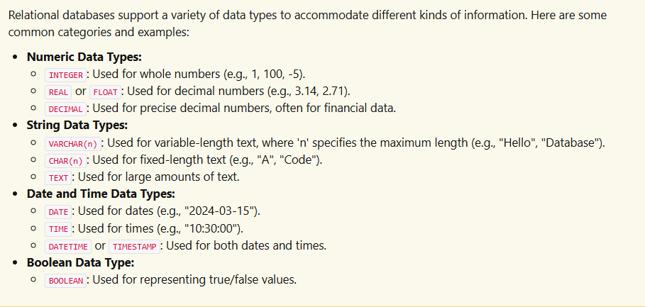
Different Data Types in Relational Databases

Slide 4
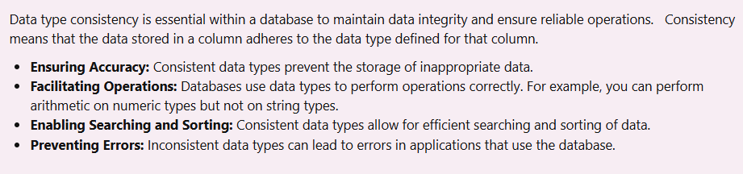
The Importance of Data Type Consistency

Slide 5
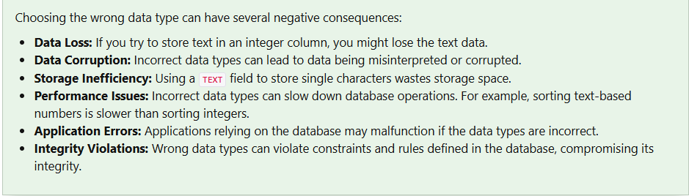
The Potential Effects of Choosing the Wrong Data Type

Slide 6
CHALLENGE
Why is it important to choose the correct data type for a column in a relational database?
What are the potential consequences of storing a string in an INTEGER column?
Explain why data type consistency is important for database operations.
Give an example of a situation where using the DECIMAL data type would be more appropriate than using FLOAT.

